Slide 1
New member orientation
2017/2018
Notes:
Instructor notes: We’ve learned that a thorough orientation is an important member retention tool, so we prepared this presentation for you to share with new club members or potential new members.
Feel free to make this presentation your own. Save it electronically, fill in the blanks or tailor the slides to meet your club’s needs. If you decide to add new slides, please maintain the integrity of the Kiwanis graphic standards by using the “Insert New Slide” function.
This is designed as a 30 minute experience.
Here’s the equipment you’ll need:
Instructor’s guide (the PowerPoint notes pages)
A laptop computer, the PowerPoint file and an LCD projector if you are anticipating a large group
A handout of slides for participants (optional)

Slide 2
New member orientation
Topics we will cover today:
Who we are
About our club
About Kiwanis International
Questions and wrapping it up
Notes:
Instructor notes: Click to bring in each topic.
Who we are— We will do a quick overview of who we as Kiwanians are and where we are.
About our club— Every club has its own “flavor”, its own traditions and projects, and its own wonderful way of interacting with the community where it exists. We will talk more about out club and the things that make our club special and important to our community.
About Kiwanis International— While all clubs are unique, they share one thing in common– they are part of a strong international organization that supports the work of clubs around the world. We will briefly discuss Kiwanis International and the ways this organization supports our local club.
Questions and wrapping it up— At the end of our time together, we will take a few moments to answer questions that you might have about our club or Kiwanis International. Of course, our members will always be available to answer questions for you later as well.
Our goal for today is simple: to help you become familiar with our club and our organization as a whole. We believe that Kiwanis International offers a unique way to serve children due to the fact that our organization is global and has a large outreach, while keeping a focus on local issues and service to children. We are glad you have chosen to join us.
We will know we have met our goal today if you:
Learn new information about Kiwanis which you are able to share with others
Understand how our club functions in our community
Understand why Kiwanis International is important to our community and to the global community

Slide 3
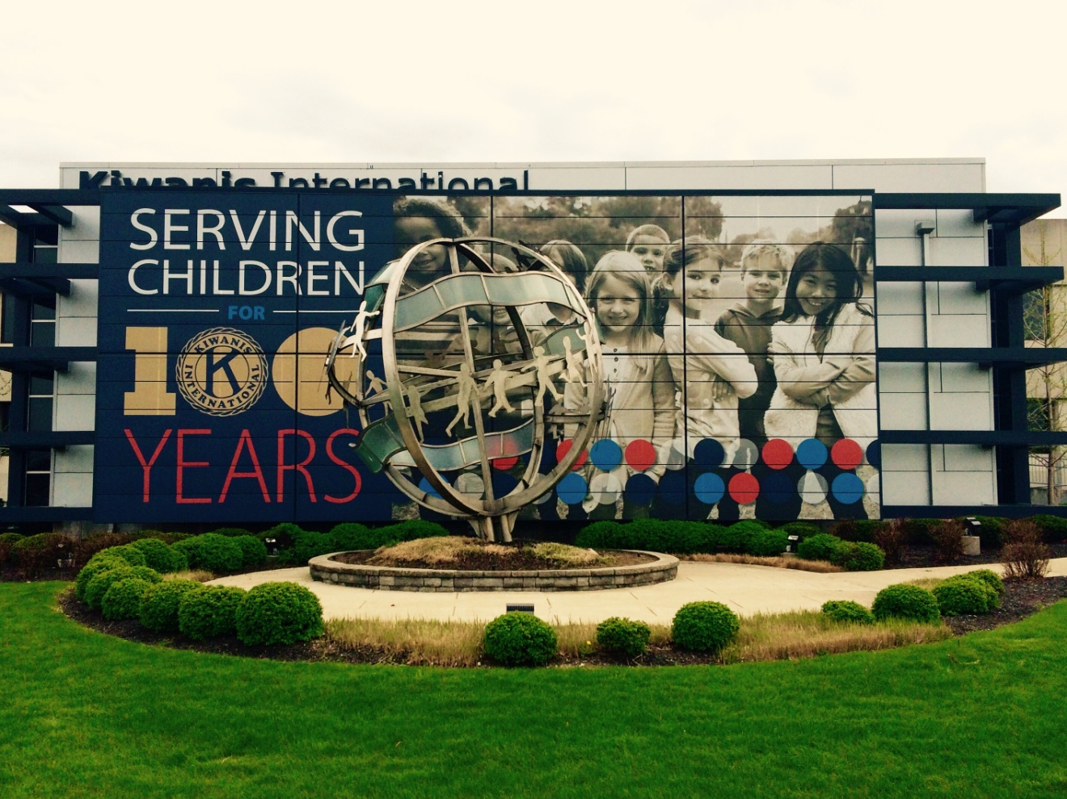
Welcome to Kiwanis!
Notes:
We excited that you’re joining our club, and we want to understand what has attracted you to become a member. So tell me, what drew you to becoming a member in our club?
(Knowing this will help us connect you to different members and activities to ensure your experience is valuable.)

Slide 4

Who we are
What is Kiwanis?
Our defining statement
Kiwanis is a global organization of volunteers dedicated to improving the world one child and one community at a time.
Notes:
The defining statement (on the slide) of Kiwanis International offers a quick and thorough answer to the question “What is Kiwanis?”
Instructor notes: Presenters may want to memorize the defining statement and share it with others along with what the district and club are doing to improve the community.
The more the community understands Kiwanis, the more they will want to join us. The more members we have, the more hands to be of service, the greater our impact in our community.

Slide 5

Who we are
Our motto:
Serving the children of the world
What do we do?
Each year, Kiwanis clubs:
  Sponsor nearly 150,000 service projects
  Raise more than US $100 million
  Devote more than 18.5 million hours to service
Notes:
Our motto says it all….we are here to serve the children of the world. Our clubs do this by working in communities to better the lives of children through service projects and fundraising. Each year, our clubs sponsor nearly 150,000 service projects, devoting more than eighteen and half million hours to service. Our members also are fundraising to support those projects. We raise more than 100 million US dollars every year to fund our projects. So as you can see, our members adopt our motto and live it in their daily lives.
All figures approximate as of October 10, 2015, and subject to change.

Slide 6
Who we are
Why are we here?
To improve lives through fellowship in service worldwide
Where is Kiwanis?
Over 7,000 Kiwanis clubs in 81 countries
When did Kiwanis begin?
One hundred years ago in 1915 in Detroit, Michigan
Notes:
So, we are here to improve lives around us. And in doing so, we enjoy the fellowship of others in our community who are like-minded. But our community is not alone in this mission. While our club directly impacts our community, there are more than 7,000 clubs all over the world doing the same thing. Together, our efforts are changing the world we live in. Kiwanis International has been doing this for 100 years, and is more impactful than ever.

Slide 7




Kiwanis International Structure
Club
Division
Kiwanis International
District
Notes:
Instructor notes: Members will benefit from knowing more about your district and how your club fits in to the overall Kiwanis structure. If you’d like to present more information about your structure, contact your Kiwanis district office for the latest details.
Here is how Kiwanis leadership is organized. It starts at the club level with our members. Our club belongs to a division with XX clubs and its own set of leaders, most notably a lieutenant governor who supports the clubs in the division. The next layer of leadership is the district which is led by our governor. There are 50 districts around the world. And, finally, we have Kiwanis International which houses all of the districts and provides support to all clubs through this structure.
As you can see, this multi-leveled leadership construction means our club is supported by a larger network of leaders who are prepared to help us be successful as we work to help our community.

Slide 8
About our club
Notes:
Let’s start with a little detail about our community’s club.
Instructor notes: The slides in this section were created to be filled in by your club officers. Please personalize these slides to relay information about your club to new members.

Slide 9

About our club
Club name: ______________________
Kiwanis Club
Charter date: ____________________
Notes:
ENTER YOUR CLUB NAME AND THE DAY YOU CHARTERED.
MANY MEMBERS DON’T EVEN REALIZE HOW MUCH HISTORY YOUR CLUB HAS!

Slide 10
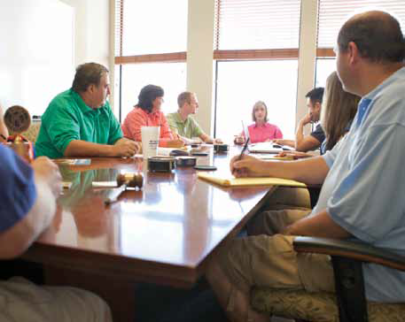
About our club
Club committees
Financial review*
Membership
  Invitation/Retention
  Education
  Public relations
Programs
  Club meetings
  Special events
Service and fundraising
  Community services
  Service Leadership Programs
*The only committee required by the Kiwanis International Standard Form for Club Bylaws
Notes:
.
Committees provide opportunities for participation and leadership. Each club has a list of standing committees within their bylaws and policies. But many clubs over the years have continued to add committees for different functions, such as specific fundraisers and service activities.
These are the standard committees listed in the Standard Form for Club Bylaws and policies. Larger clubs may have more committees to provide more opportunities for members to get involved; some small clubs combine or prioritize these committees. Focus on the work the club needs or wants to accomplish. Describe what each committee does. Club committees are where the work gets done and relationships are forged. Encourage new members to find a committee that interests them and to play a part.

Slide 11
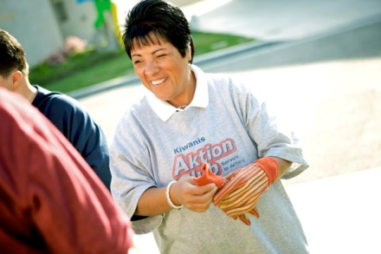
Our club’s service projects
Our club’s service projects
WHAT WOULD YOU LIKE TO SEE HERE?
Disaster Backpacks
Project name here
Project name here
Project name here
Notes:
Relationships are forged by participating in the activities of the club.
Give new members an opportunity to participate in a service project right away.
Find out if the new member has a particular interest in one of those or has suggestions for other projects

Slide 12
Club’s fundraising Ideas
Our club’s fundraising projects
fundraiser name here
fundraiser name here
fundraiser name here
fundraiser name here
Notes:
As with service projects and committee assignments, relationships are forged by participating in the activities of the club.
Does anyone have any ideas?

Slide 13

About our club
Our club’s traditions
Pledge
Prayer
Sing?
Happy Dollars?
Notes:
Instructor notes: Describe a typical club meeting including format and timing (and timeliness), seating (hopefully “open”) and club traditions such as Happy Dollars. Take time to explain to new members (and guests) what to expect (singing, meals, committee reports, etc.) so they feel comfortable at the first few club meetings.
Some clubs start meetings with an invocation and singing, some don’t. Assure the new member that his or her preferences will be considered when club traditions and club meetings are evaluated.
(Be sure to evaluate your club’s traditions annually to ensure that they continue to meet the members’ needs.)

Slide 14
Communication
How will I know what’s going on?
  Club meetings
  Newsletters – club, division and district
  Websites
    Club:
    T/O District: www.txokkiwanis.org
    Kiwanis International: www.kiwanis.org
  Kiwanis magazine
  Social media: (list if applicable)
Notes:
Sharing information is critical to keeping members engaged. When your member application is processed, you will receive an e-mail invitation to the New Member e-Welcome Kit that contains special information just for new members including special discounts.

Slide 15

About our club
Club leaders Needed
President:
Immediate past president: starts year 2
President-elect or vice-president:
Secretary:
Treasurer:
Board Members (minimum 3)
Notes:
Explain that officers change with each administrative year, which begins October 1.
Describe the election process for club directors and officers.
Explain what the annual club meeting is.
Share the date of the club’s next Annual Club Meeting which is likely in April or May.
Encourage new members to consider running for office.

Slide 16
Who Are Our Club Officers?
President: _____________________
President-Elect: _____________________
Secretary: _____________________
Treasurer: ______________________
Board Members:
Notes:
LIST YOUR OFFICERS AND BOARD MEMBERS

Slide 17

Club business
Members vote to:
  Elect club officers and directors
  Amend club bylaws
The board of directors:
  Determines club policies
  Approves club projects
  Approves and controls club budget
  Approves membership applications
  Manages the club
Notes:
Briefly explain the structure of voting and the responsibilities of the board of directors for your club.

Slide 18

Club business
Board of directors meeting
  All members are welcome
  Only board members can vote
Day:
Time:
Location:
Notes:
Explain that all members are welcome to attend board meetings, but only board members and officers may vote.

Slide 19
Club business
Finance & budget
Administrative account
  Income from club dues, meal charges, new member fees
  Used to pay administrative expenses of club
Service account
  Income from public fundraising projects or contributions
  Cannot be used to pay club administrative expenses of the club.
Notes:
In the United States……
Kiwanis clubs are classified as 501(c)4 organizations and dues/donations are not tax deductible.
Some clubs have 501(c)3 foundations that can accept tax deductible contributions.

Slide 20
Club business
Charter Membership
New member fee: $____________ Background Checks $5.85
(covers the cost between October 1, 2017 – Sept. 30, 2018)
Notes:
If applicable, describe additional “typical” costs of membership. If your club meets during a meal time, what is the expected cost of the meal? Is it expected that members will contribute to Happy Dollars, division/district events, foundations, etc?
The new member fee includes $50 to Kiwanis International and a portion to your district and division.

Slide 21
Club Dues
District: $26.50
Kiwanis International: $77.00 (includes insurance and magazine) __________________
Sub Total $103.50
Club Administrative Costs $_______
Other Costs eg. Foundation Donations $25.00 _________
Total Dues per Year $________
Notes:
Dues are discounted if paid at one time????
Administrative Costs help to run your club.
Let your members decide!!

Slide 22
Member benefits
Club benefits
Providing Leadership for Students
Helping Non Profits in your community
Working together to create a positive change
Division benefits
Working with other clubs to network
Working with other clubs to make a difference
District benefits
An amazing Disaster Relief Program
Meeting other like minded individuals all over Texas and Oklahoma!
Notes:
Instructor notes: Include club, division or district benefits (i.e. district and club newsletters, education conferences, leadership education, social and networking experiences). Delete any content that is not relevant to your club.

Slide 23
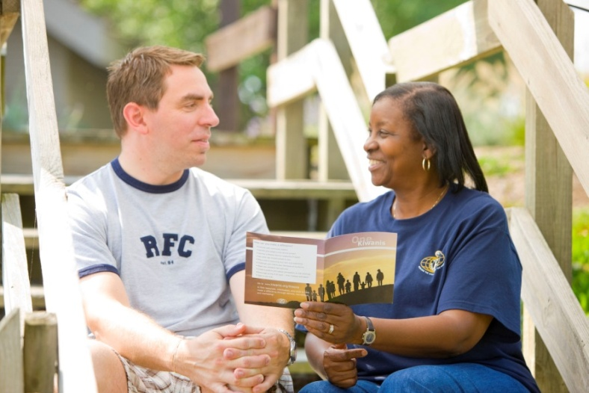
Participation
  How do I get involved?
  Attend club meetings
  Participate in service and fundraising projects
  Attend district council meetings
  Participate in inter-club meetings
  Serve on committees
  Run for office
  Spread the word about
  Kiwanis
Notes:
You are welcome to get involved in a number of ways. We know that people are leading busy lives, and understand that you are here to help in any way you can—we are grateful. Here is a list of common ways that members help our club.
(Share list)
Now we’ll share more information on our structure to give you a better understanding how our club fits into the larger picture of Kiwanis.

Slide 24







Service Leadership Programs
Kiwanis Service Leadership Programs
  The largest and oldest youth service clubs in the world
  Program for adults living with disabilities
  341,000 members worldwide
Notes:
Ask about new members’ experiences with the Service Leadership Programs. Many are familiar with Key Club and Circle K International but may not associate the programs with Kiwanis.
We define Service Leadership as the next step beyond service learning. Once a young person fully understands the concept of learning by helping others, he or she begins to grow personally as a leader. Our Service Leadership Programs are a great way to inspire the next generation of leaders. The visibility of our Service Leadership Programs can also be a positive incentive for parents, teachers, school administrators, youth ministers, and others interested in the welfare of students.

Slide 25

Key Club
Name: ______________Key Club
Meeting time: __________________________
Location: ___________________________
Advisor: ____________
260,000 high school
leaders
30 countries
Complete more than
12 million hours of service
Notes:
Kiwanis International empowers people at every stage of life to become competent, capable, and compassionate leaders by helping them learn to help others. Through its Service Leadership Programs, Kiwanis teaches students and adults ways to improve the world one child and one community at a time.
IF YOU DON’T HAVE A KEY LCUB TAKE OFF THE INDIVIDUAL SCHOOL NFORMATION BUT LEAVE THE REST OF THE SLIDE.

Slide 26
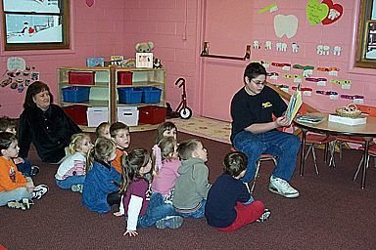
Builder’s Club
Nearly 45,000 middle
and junior high students
1,500 clubs in 18 nations
Provides service to
school and community
by developing leadership and people skills
(Your School District)
___________ Middle School
Notes:
IF YOU DON’T HAVE A BUILDERS CLUB THEN TAKE OFF THE LAST TWO LINES BUT LEAVE THE INFORMATION

Slide 27
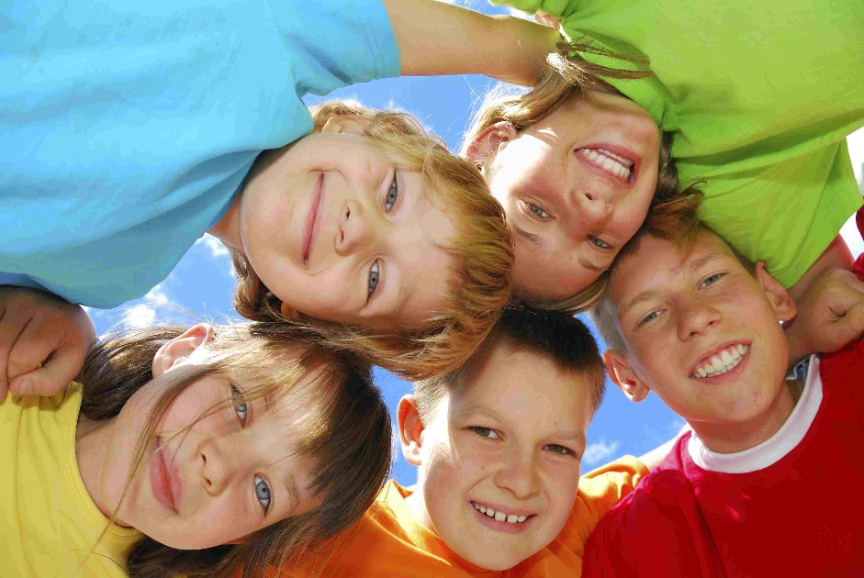
K-Kids
Student-led
community service
organization
Elementary students
Teaches values of
helping others through
participation in community
service projects and club activities
________________ K-Kids
Notes:
IF YOU DON’T HAVE A K-KIDS TAKE OFF LAST LINE

Slide 28

Bring Up Grades
Designed to recognize students who raise their grades into an acceptable range, and maintain or continue to raise them from one grading period to the next.
__________________ Elementary School
Notes:
IF YOU DON’T DO THIS JUST TAKE OFF LAST LINE BUT LEAVE THE INFO

Slide 29

Terrific Kids
Student recognition program promoting character development, self-esteem, and perseverance
Students work with teachers to establish goals to improve behavior, attendance and school work
Notes:
IF YOU HAVE TERRIFIC KIDS ADD THE NAME OF THE SCHOOLS

Slide 30
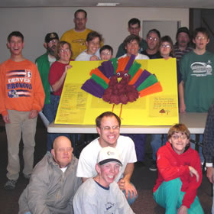
Aktion Club
Over 400 clubs in seven nations
Allows adults with disabilities to develop initiative and leadership skills through hands-on service
Notes:
IF YOU HAVE AN AKTION CLUB.....ADD THEIR NAME TO THIS SLIDE!

Slide 31
Texas Oklahoma District
Notes:
Kiwanis International has one hundred and two years of serving the children of the world. And it is through clubs like ours that Kiwanis has maintained a reputation as an outstanding service organization for 100 years. Let’s look at the structure of Kiwanis International.

Slide 32
District Structure
We are in Division ___________lead by Lt. Governor __________________
Sister clubs include:
(List Your Other clubs Here)

Slide 33
District Structure
Division________is in the ___________ Region We have 10 regions in our District Our Trustee is ____________
Our District is all of Oklahoma and Texas except for El Paso, which is in the Southwest District. Our Governor is Patrick Schibi until Oct. 1 and then it will be Ralph Keen

Slide 34
District Office
Our District Office is in Pantego, TX
The Administrative Supervisor for our District is Laura Arnhart
District Secretary is Lee Shuey
District Treasurer is Erby Eikner

Slide 35

Texas Oklahoma District Foundation
Key Leader
Disaster Relief
Key Club Scholarships
Circle K Scholarships
Sophomore of the Year
Women in Kiwanis

Slide 36
Kiwanis International
Notes:
Kiwanis International just celebrated it’s centennial…one hundred years of serving the children of the world. And it is through clubs like ours that Kiwanis has maintained a reputation as an outstanding service organization for 100 years. Let’s look at the structure of Kiwanis International.

Slide 37
The Kiwanis Objects
1. To give primacy to the human and spiritual rather than to the material values of life.
2. To encourage the daily living of the Golden Rule in all human relationships.
3. To promote the adoption and the application of higher social, business, and professional standards.
Notes:
Go over the Objects. The next slide contains the last 3 Objects.
The Kiwanis International Objects are our guiding principles. They were approved by Kiwanis club delegates at the 1924 convention in Denver, Colorado. They’ve inspired generations of Kiwanians—and they still hold true today.

Slide 38
The Kiwanis Objects
4. To develop, by precept and example, a more intelligent, aggressive, and serviceable citizenship.
5. To provide, through Kiwanis clubs, a practical means to form enduring friendships, to render altruistic service, and to build better communities.
6. To cooperate in creating and maintaining that sound public opinion and high idealism which make possible the increase of righteousness, justice, patriotism, and goodwill.
Notes:
These objects are the driving force behind everything Kiwanis does. But it takes strong leadership to keep any group of people focused on the mission at hand. Kiwanis International supports a structure of leadership which helps clubs fulfill their primary purpose.

Slide 39
KI Top Officers
          PRESIDENT
Jim Rochford
Illinois
Immediate Past President-Elect
President Poly Lat
John Button Philippines
Canada

Slide 40
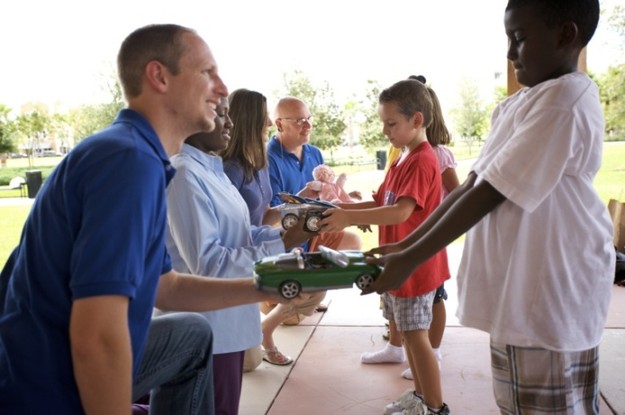
Member benefits
What’s in it for me?
  Change children’s lives
  Improve the community and the world
  Build friendships
  Enhance leadership skills
  Develop business contacts
Notes:
We hope to get you involved quickly in our service projects. We feel it is important that new members have an opportunity to participate in a service project right away. We want you to understand that feeling of pride and fulfillment that comes from being a part of an organization that makes a difference. This feeling of accomplishment is only one of the benefits of being a part of our local Kiwanis club. (Discuss other benefits on slide. You may use the script below, add to it or create your own comments regarding the benefits listed.)
As a member of Kiwanis, you have the chance to change the lives of children all around the world. You will act locally in our community to improve the lives of area children, but our impact as an organization is felt worldwide. You will no doubt build new friendships through serving side-by-side with like-minded people. You will enhance your own leadership skills, and help develop leadership skills in the children we serve. You can also develop business contacts through your relationships in the club and the community. It is what we like to call a “win-win” situation, one where you benefit from being of service to others.

Slide 41


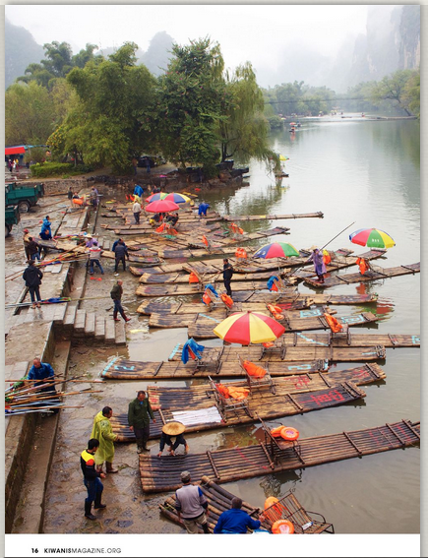

More perks…
Kiwanis member magazine with inspiring stories and from around the world
Kiwanis marketplace
Notes:
But those are not the only benefits you will find here. Our magazine is a stand-out. It features amazing images and fascinating stories from around the world. These stories will inspire and inform you about how Kiwanis is impacting communities around the globe.
Beyond the club benefits of service and fellowship, members can also enjoy a host of member benefits found in our Marketplace. Kiwanis Travel, Kiwanis Insurance, Kiwanis Warehouse and Kiwanis Visa Rewards are all programs available to our members. Go to www.kiwanis.org/marketplace to find out more about our money-saving programs.

Slide 42
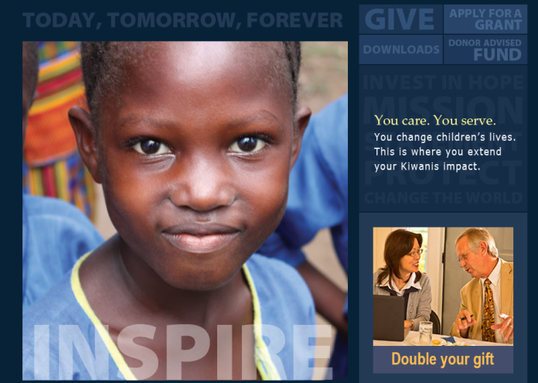
Kiwanis International Foundation
The Kiwanis International Foundation
aka Kiwanis Children’s Fund
  You are a member!
  Charitable fundraising entity of Kiwanis International
  Fund grants are awarded for activities and programs
  Annual club gift campaign
  Personal philanthropy
  Visit: www.Kiwanis.org/foundation
Notes:
The Kiwanis International Foundation will solicit funds directly from our members (via postal mail). Share with the new member any other ways that the club also supports the Kiwanis International Foundation.
The Kiwanis International Foundation:
Supports the Kiwanis community on a global scale.
Provides the recognition and publicity for club contributions.
Provides money for matching scholarships to Key Clubs and Circle K clubs in your district.
Provides grants to clubs and districts to provide service to children.
Provides funds to support Kiwanis family programs at the International level.
Instructor notes: Differentiate between the Kiwanis International Foundation and district/club foundations.

Slide 43
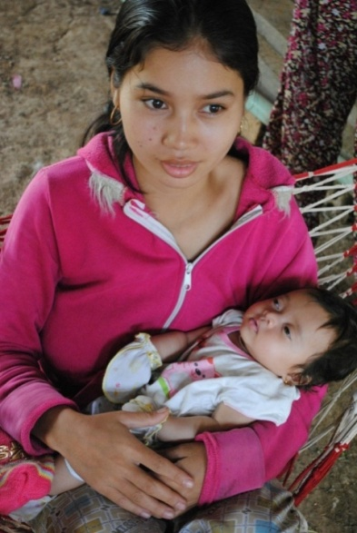
The Eliminate Project
The Eliminate Project
  Partnership with UNICEF
  Goals:
    To eliminate maternal/neonatal tetanus
    To raise US$110 million by 2015
For more information, visit: www.TheEliminateProject.org
Notes:
This is Kiwanis International’s global campaign for children. Our goal is to raise $110 million by the end of 2015 to fight maternal/neonatal tetanus.
Instructor notes: Share your club’s plans for involvement in the project.
f you’d like to share more information about the project, you can find resources including a PowerPoint presentation at www.TheEliminateProject.org.

Slide 44
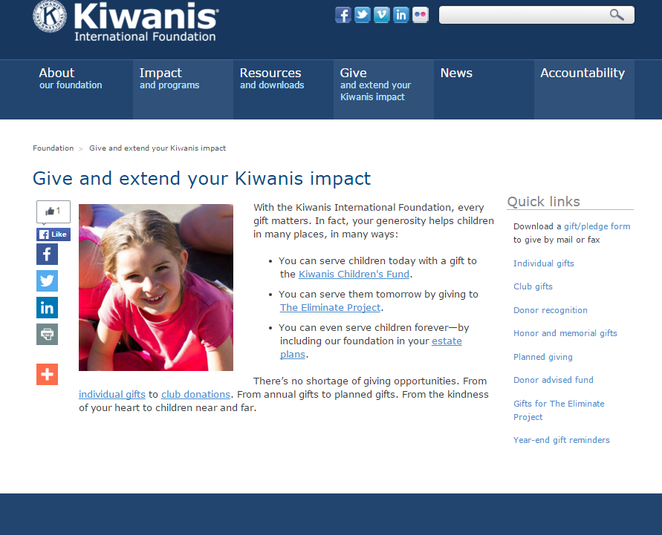
Kiwanis Children’s Fund
Notes:
With the Kiwanis International Foundation, every gift matters. In fact, your generosity helps children in many places, in many ways.
You can serve children today with a gift to the Kiwanis Children’s Fund.
You can even serve children forever—by including our foundation in your estate plans.
There’s no shortage of giving opportunities. To learn more, visit: www.kiwanis.org/foundation/give-and-extend-your-kiwanis-impact.

Slide 45
Kiwanis partners
  Kiwanis partners bring value to your club by providing services and products that enhance our service and work in your community.
  For a current list of Kiwanis partners and resources to help you work with the different partners, visit: www.KiwanisOne.org/partners
Notes:
Kiwanis International believes in working collaboratively with businesses and organizations that share in our dedication to serving children. Here are some of our national partnerships.
Our partner’s products, services and reputation must:
Be compatible with and complementary to Kiwanis’ mission and values
Reflect a high degree of integrity
Demonstrate a track record of high-quality products or services

Slide 46
Conventions
Events:
  Governor’s Visits:
  District convention – Abilene, TX
  Kiwanis International convention – Las Vegas
  Key Club International convention - Chicago
  Circle K International convention - Chicago
Notes:
Discuss dates and locations of upcoming conventions and, if appropriate, club policies for sending members to each of these events.
Kiwanis International conducts an annual convention, which is held to:
Elect International Board members
Amend the International Bylaws
Provide Kiwanis fellowship
Provide Kiwanis education
New members receive a free registration to the Kiwanis International convention within their first year of membership. Be sure to call Kiwanis International for more details about this opportunity.
Each club is allowed to have two delegates and two alternates. These delegates compose the House of Delegates and vote on the election of officers and new members to the Board of Trustees, resolutions, and proposed amendments to the Kiwanis International Bylaws.
District conventions and conferences achieve the same objectives but at the district level. Some districts have regional meetings.

Slide 47

Questions?
Notes:
Open the floor to questions.

Slide 48
Wrapping it up
Contact information:
Notes:
Supply contact information for a couple of club members who are available to answer questions that attendees might have after the meeting adjourns. You might also supply the meeting time and date for the next meeting.
Another idea is to assign a club member to contact these people a couple of days prior to the next meeting so that they know they are invited to attend. It always helps to reach out and help new people feel welcomed!

Slide 49
Thank you for attending!
We hope you will enjoy being a part of our club and serving the children of the world.

